Slide 1
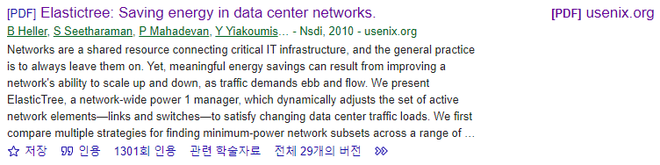
ElasticTree: Saving Energy in Data Center Networks
Brandon Heller⋆ , Srini Seetharaman† , Priya Mahadevan⋄ , Yiannis Yiakoumis⋆ , Puneet Sharma⋄ , Sujata Banerjee⋄ , Nick McKeown⋆ ,
Nsdi. Vol. 10. 2010.
22.12.06.
Cloud Computing
Sohee Kim
Notes:
Heller, Brandon, et al. "Elastictree: Saving energy in data center networks." Nsdi. Vol. 10. 2010.
https://www.usenix.org/legacy/event/nsdi10/tech/full_papers/heller.pdf

Slide 2


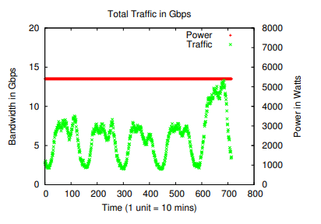
1. Introduction
Heller, Brandon, et al. "Elastictree: Saving energy in data center networks." Nsdi. Vol. 10. 2010.
Data centers consume huge amounts of energy
Most efforts to reduce energy consumption in Data centers is focused on servers and cooling, which account for about 70% of a data center’s total power budget
Networking elements are responsible for 10~20% of power usage in a data center
3 billion kWh in 2006[US] by networking elements -> rising
This paper focus on reducing growing energy cost (network power consumption)
Data centers are typically provisioned for peak workload
During lower traffic, most of the network components are idle, still using power
Traffic collected from 292 servers hosting an E-commerce application over a 5 days period
The traffic peaks during the day and falls at night
Even though traffic varies significantly with time, the associated switches draw a constant power
Notes:
Data centers consume huge amounts of energy, and Most efforts to reduce energy consumption in Data centers is focused on servers and cooling, which account for about 70% of a data center’s total power budget.
Networking elements are responsible for 10~20% of power usage in a data center
The total power consumed by networking elements in data centers in 2006 in the U.S. alone was 3 billion kWh and rising
So This paper’s goal is reduce this rapidly growing energy cost, network power consumption
Data centers are typically provisioned for peak workload, and run well below capacity most of the time.
During lower traffic, most of the network components are idle, still using power
This figure shows aggregate traffic collected from 292 servers hosting an e-commerce application over a 5 day period.
The traffic peaks during the day and falls at night.
Even though the traffic varies significantly with time, the rack and aggregation switches associated with these servers draw constant power (secondary axis in Figure 2).

Slide 3
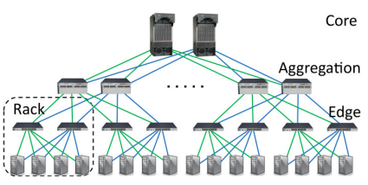
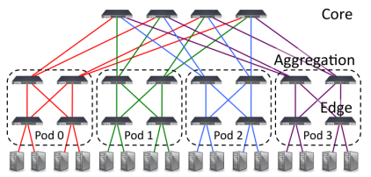
1. Introduction
Heller, Brandon, et al. "Elastictree: Saving energy in data center networks." Nsdi. Vol. 10. 2010.
Data Center Networks
Typical Data Center Network (2N)
Fat tree
Built from a large number of richly connected switches, and can support any communication pattern.
In a typical DCN(2N tree) - One failure can cut the effective bisection bandwidth in half, while two failures can disconnect servers.
Richer, mesh-like topologies (like the fat-tree) handle failures more gracefully
With more components and more paths, the effect of any individual component failure becomes manageable
This can be used in improving energy efficiency, by dynamically varying the number of active network elements
It can be thought as a control knob to tune between energy efficiency, performance and fault tolerance
Notes:
As services scale beyond ten thousand servers, inflexibility and insufficient bisection bandwidth have prompted researchers to explore alternatives to the traditional 2N tree topology
One such example, the fat tree [1] 2 , seen in Figure 1(b), is built from a large number of richly connected switches, and can support any communication pattern
In a 2N tree, one failure can cut the effective bisection bandwidth in half, while two failures can disconnect servers.
Richer, mesh-like topologies handle failures more gracefully; with more components and more paths, the effect of any individual component failure becomes manageable.
This property can also help improve energy efficiency. By dynamically varying the number of active (powered on) network elements.
It can be thought as a control knob to tune between energy efficiency, performance, and fault tolerance

Slide 4
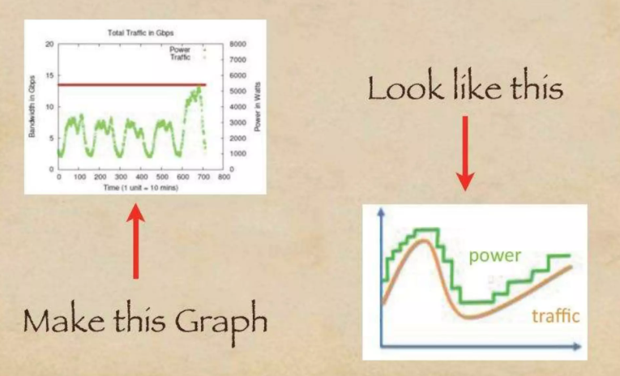
1. Introduction
Heller, Brandon, et al. "Elastictree: Saving energy in data center networks." Nsdi. Vol. 10. 2010.
Energy Proportionality
Unfortunately, today’s network elements are not energy proportional
Fixed overheads such as fans, switch chips, and transceivers waste power at low loads.
However, maximum efficiency can be realized by a combination of improved components and improved component management.
Choice : To manage today’s non energy-proportional network components more intelligently
The Strategy is simple
Turn off the links and switches that we don’t need to keep available only as much networking capacity as required
ElasticTree is a network-wide energy optimizer that continuously monitors data center traffic conditions.
It chooses the set of network elements that must stay active to meet performance and fault tolerance goals
Then it powers down as many unneeded links and switches as possible
https://www.slideshare.net/abhisheksutrave/elastic-tree-saving-energy-in-data-center-networks
Notes:
Unfortunately, today’s network elements are not energy proportional
Fixed overheads such as fans, switch chips, and transceivers waste power at low loads.
However, maximum efficiency can be realized by a combination of improved components and improved component management.
So The authors’ choice is to manage today’s non energy-proportional network components more intelligently
The Strategy in this paper is simple
Turn off the links and switches that we don’t need to keep available only as much networking capacity as required
Fault tolerance = 고장 허용 범위

Slide 5
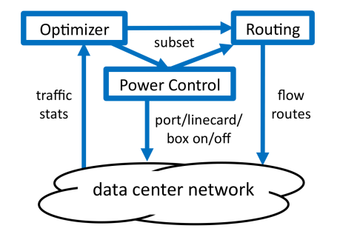
2. ELASTIC TREE
Heller, Brandon, et al. "Elastictree: Saving energy in data center networks." Nsdi. Vol. 10. 2010.
Elastic Tree
It is a network-wide power manager, which dynamically adjusts the set of active network elements-links and switches- to satisfy changing data center traffic loads
It consists of three logical modules
System Diagram
Optimizer
To find the minimum power network subset which satisfies current traffic conditions
Inputs : topology, traffic matrix, a power model for each switch, desired fault tolerance properties
Outputs : a set of active components to both the power control and routing modules
Routing
Choosing paths for all flows then pushes routes into the network
Power Control
Toggles the power states of ports, line cards, and entire switches
Choosing paths
toggle
Notes:
ElasticTree consists of three logical modules - optimizer, routing, and power control - as shown in Figure.
The optimizer’s role is to find the minimum power network subset which satisfies current traffic conditions. Its inputs are the topology, traffic matrix, a power model for each switch, and the desired fault tolerance properties (spare switches and spare capacity).
The optimizer outputs a set of active components to both the power control and routing modules.
Power control toggles the power states of ports, line cards, and entire switches,
while routing chooses paths for all flows, then pushes routes into the network

Slide 6
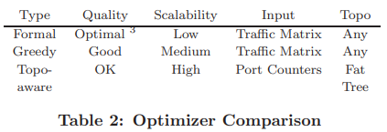
2. ELASTIC TREE
Heller, Brandon, et al. "Elastictree: Saving energy in data center networks." Nsdi. Vol. 10. 2010.
Optimizers
A range of methods to compute a minimum-power network subset in Elastic Tree
Role is to find minimum-power network subset which satisfies current traffic conditions
There are 3 different methods for computing a minimum power network subset
Formal Model
Greedy-Bin Packing
Topology-aware Heuristic
Each method achieves different tradeoffs between scalability and optimality
Methods can be further improved by considering a data center’s traffic history
Notes:
They have developed a range of methods to compute a minimum-power network subset in ElasticTree, as summarized in Table.
The Role is to find minimum-power network subset which satisfies current traffic conditions
The first method is a formal model, mainly used to evaluate the solution quality of other optimizers, due to heavy computational requirements.
The second method is greedy bin-packing, useful for understanding power savings for larger topologies.
The third method is a simple heuristic to quickly find subsets in networks with regular structure.
Each method achieves different tradeoffs between scalability and optimality
Methods can be further improved by considering a data center’s traffic history
The model starts with a standard multicommodity flow (MCF) problem

Slide 7
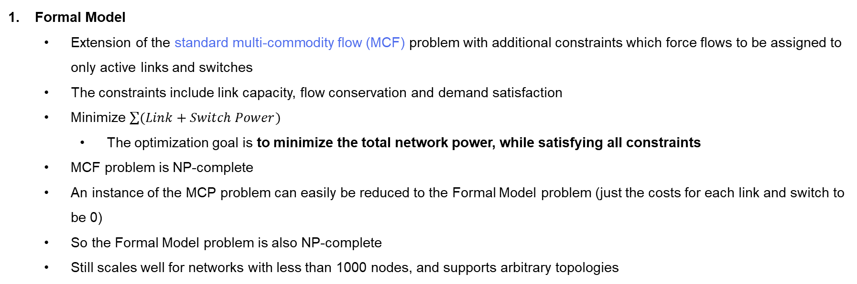
2. ELASTIC TREE
Heller, Brandon, et al. "Elastictree: Saving energy in data center networks." Nsdi. Vol. 10. 2010.
Optimizers
Formal Model
Extension of the standard multi-commodity flow (MCF) problem with additional constraints which force flows to be assigned to only active links and switches
The constraints include link capacity, flow conservation and demand satisfaction
Minimize $\sum{(Link+Switch Power)}$
The optimization goal is to minimize the total network power, while satisfying all constraints
MCF problem is NP-complete
An instance of the MCP problem can easily be reduced to the Formal Model problem (just the costs for each link and switch to be 0)
So the Formal Model problem is also NP-complete
Still scales well for networks with less than 1000 nodes, and supports arbitrary topologies
Notes:
They have developed a range of methods to compute a minimum-power network subset in ElasticTree, as summarized in Table.
The Role is to find minimum-power network subset which satisfies current traffic conditions
The first method is a formal model, mainly used to evaluate the solution quality of other optimizers, due to heavy computational requirements.
The second method is greedy bin-packing, useful for understanding power savings for larger topologies.
The third method is a simple heuristic to quickly find subsets in networks with regular structure.
Each method achieves different tradeoffs between scalability and optimality
Methods can be further improved by considering a data center’s traffic history
The model starts with a standard multicommodity flow (MCF) problem

Slide 8
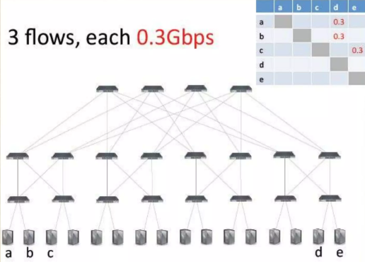
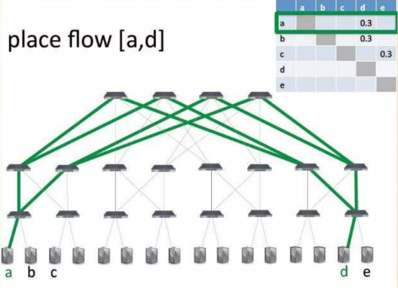
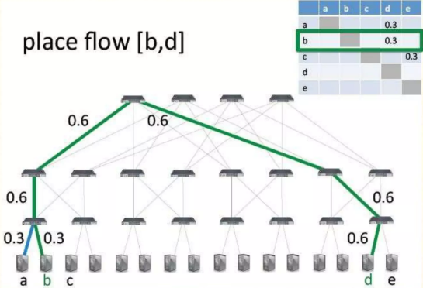
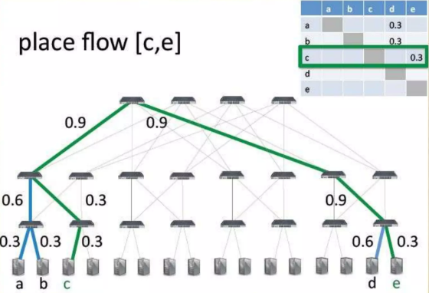
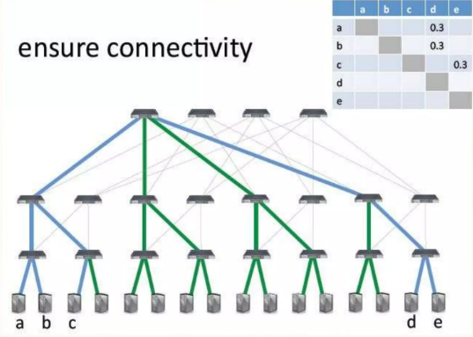
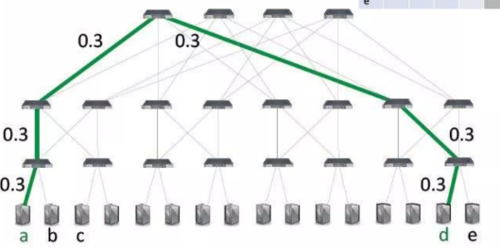
2. ELASTIC TREE
Heller, Brandon, et al. "Elastictree: Saving energy in data center networks." Nsdi. Vol. 10. 2010.
Optimizers
3 flows, each 0.3Gbps
Greedy Bin-Packing
Evaluates possible flow paths from left to right.
Greedy bin-packer evaluates possible paths and chooses the leftmost one with sufficient capacity.
Repeated for all flows
Solutions within a bound of optimal are not guaranteed, but in practice, high quality subsets result.
Place flow [a,d]
Place flow [b,d]
Place flow [c,d]
Ensure connectivity
Notes:
The greedy bin-packing heuristic improves on the formal model’s scalability.
For each flow, the greedy bin-packer evaluates possible paths and chooses the leftmost one with sufficient capacity. Repeated for all flows
For some traffic matrices, the greedy approach will not find a satisfying assignment for all flows;
In this case, the greedy search will have enumerated all possible paths, and the flow will be assigned to the path with the lowest load.
Like the model, this approach requires knowledge of the traffic matrix, but the solution can be computed incrementally, possibly to support on-line usage.

Slide 9
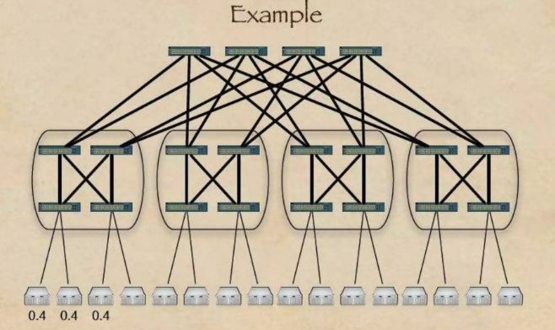
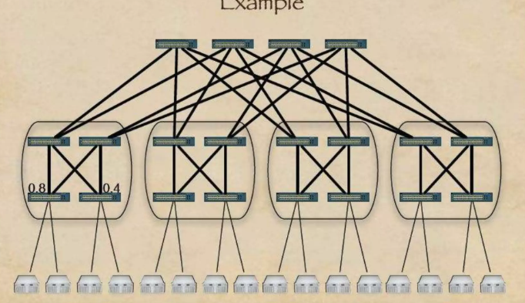
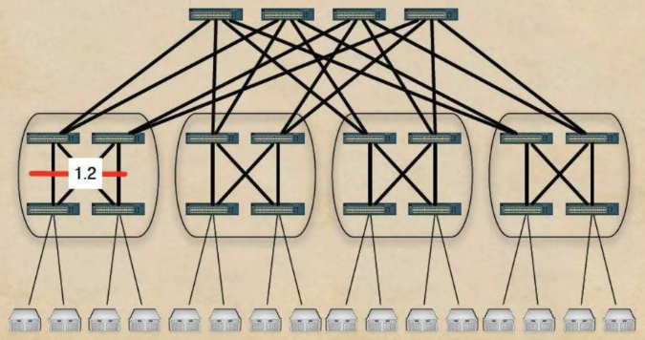
2. ELASTIC TREE
Heller, Brandon, et al. "Elastictree: Saving energy in data center networks." Nsdi. Vol. 10. 2010.
Optimizers
Topology-Aware Heuristic
Leverages regularity of fat tree topology to quickly find network subsets
Intuition : “An edge switch doesn’t care which aggregation switches are active, instead, how many are active”
0.8
0.4
1.2
0.4
0.4
0.4
Notes:
The last method leverages the regularity of the fat tree topology to quickly find network subsets.

Slide 10
2. ELASTIC TREE
Heller, Brandon, et al. "Elastictree: Saving energy in data center networks." Nsdi. Vol. 10. 2010.
3 Optimizers
Scalability
Formal
Model
Greedy
Bin-packer
Optimality (최적성)
Topo-aware
Heuristic
Scalability (확장성)

Slide 11
3. Conclusion
Heller, Brandon, et al. "Elastictree: Saving energy in data center networks." Nsdi. Vol. 10. 2010.

Slide 12
Thank You ☺

